Slide 1
Polymorphism
Polymorphism means many forms (ability to take more than one form). In Polymorphism poly means “multiple” and morph means “forms” so polymorphism means many forms.
In polymorphism we will declare methods with same name and different parameters in same class or methods with same name and
same parameters in different classes. Polymorphism has ability to provide different implementation of methods that are implemented
with same name.
In Polymorphism we have 2 different types those are
Overloading
Early Binding
Compile Time Polymorphism
Overriding
Late Binding
Run Time Polymorphism
static binding
dynamic binding

Slide 2
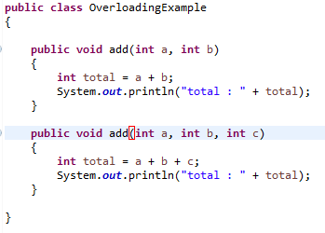
Polymorphism
Overloading
Overloading means we will declare methods with same name but different signatures because of this we will perform different tasks with same method name. This overloading also called as compile time polymorphism or early binding.
Method Overloading or compile time polymorphism means same method names with different signatures (different parameters)

Slide 3
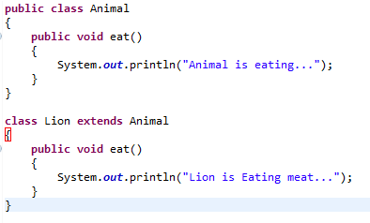
Polymorphism
Overriding
Overriding also called as run time polymorphism or late binding or dynamic polymorphism. Method overriding or run time polymorphism means same method names with same signatures.
In this method overriding or run time polymorphism we can override a method in base class by creating similar function in derived class this can be achieved by using inheritance principle
base class
derived class

